Slide 1
Microservices in Azure
What The Hack

Slide 2
Contoso Travel Web Overview
1 Web App
  App Service
2 REST Services (Data and Itinerary)
  Container Instance
1 Data Load program
  Container Instance
1 Cosmos DB Account
  1 Database
  Individual Scalable
  Document Collections for Domain Isolation
App Insights to Monitor

Slide 3
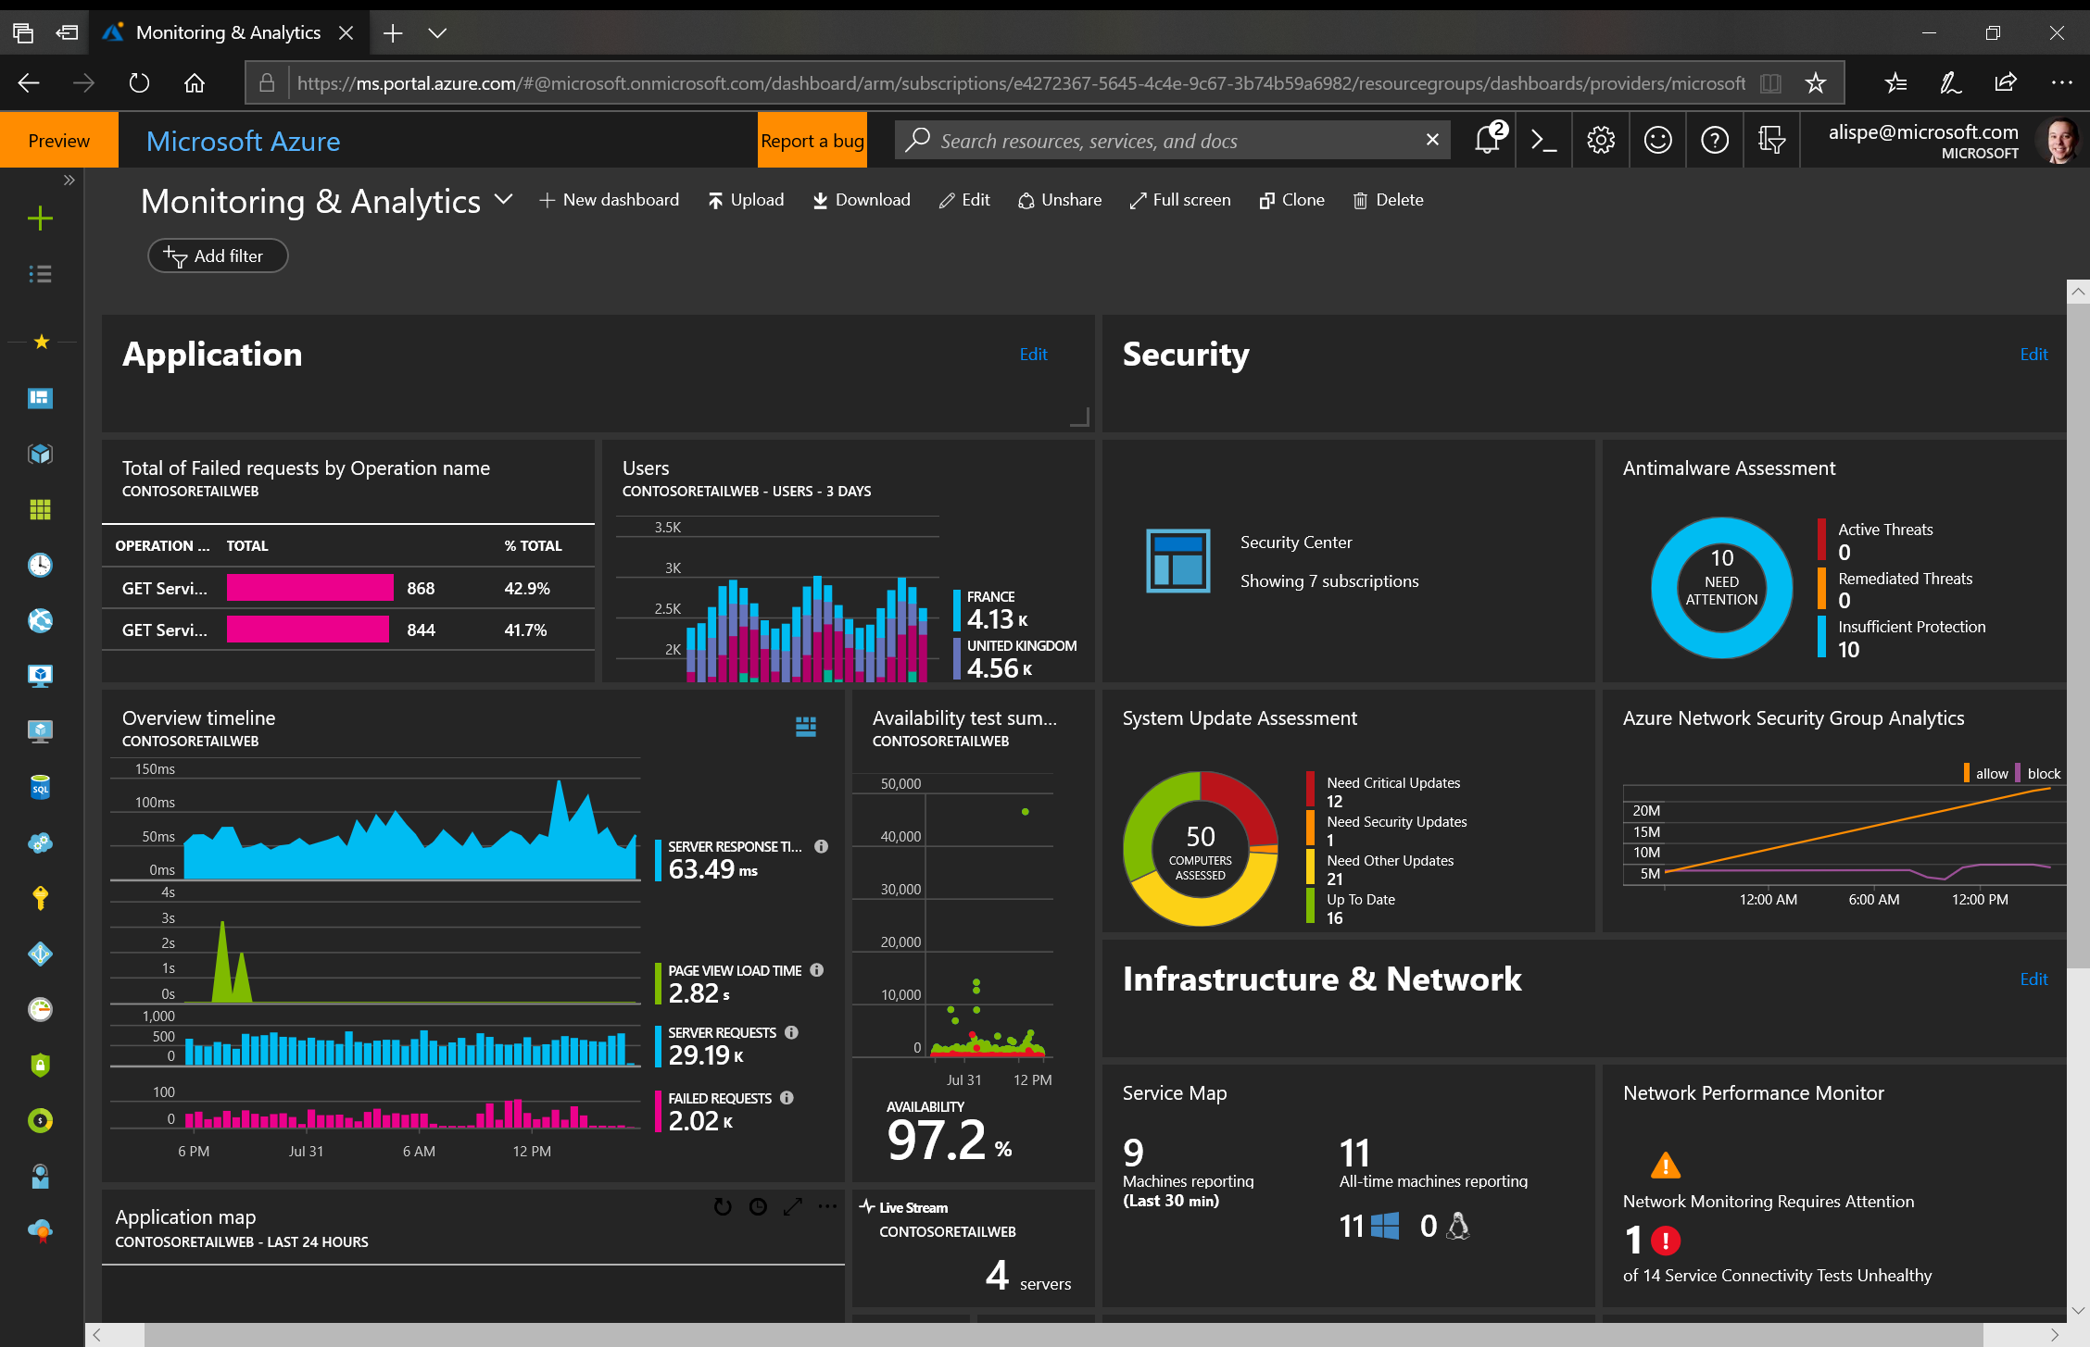
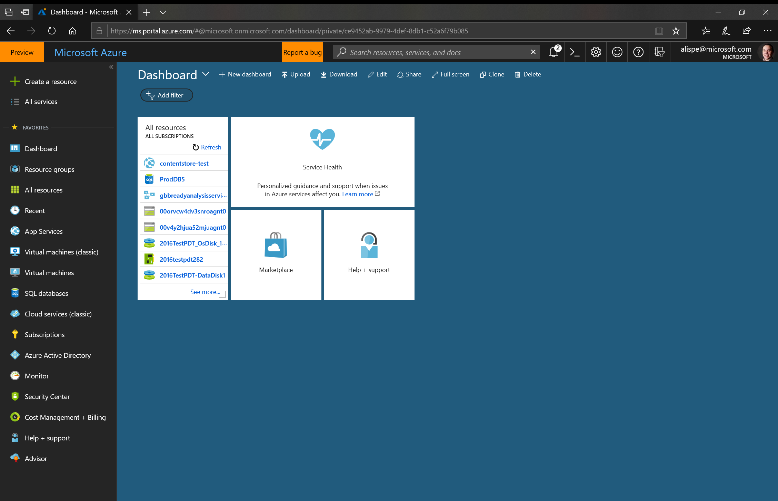
Azure Portal —portal.azure.com
See all your resources
Create portal dashboards by:
  key roles
  key projects
  key service KPIs
Use the Azure Cloud Shell!
Notes:
Central place to deploy and manage Azure resources​
Unified browser experience for various management operations​
Management web pages (referred to as blades) includes settings, actions, billing information, health monitoring, usage data, and more​
Customizable dashboards

Slide 4
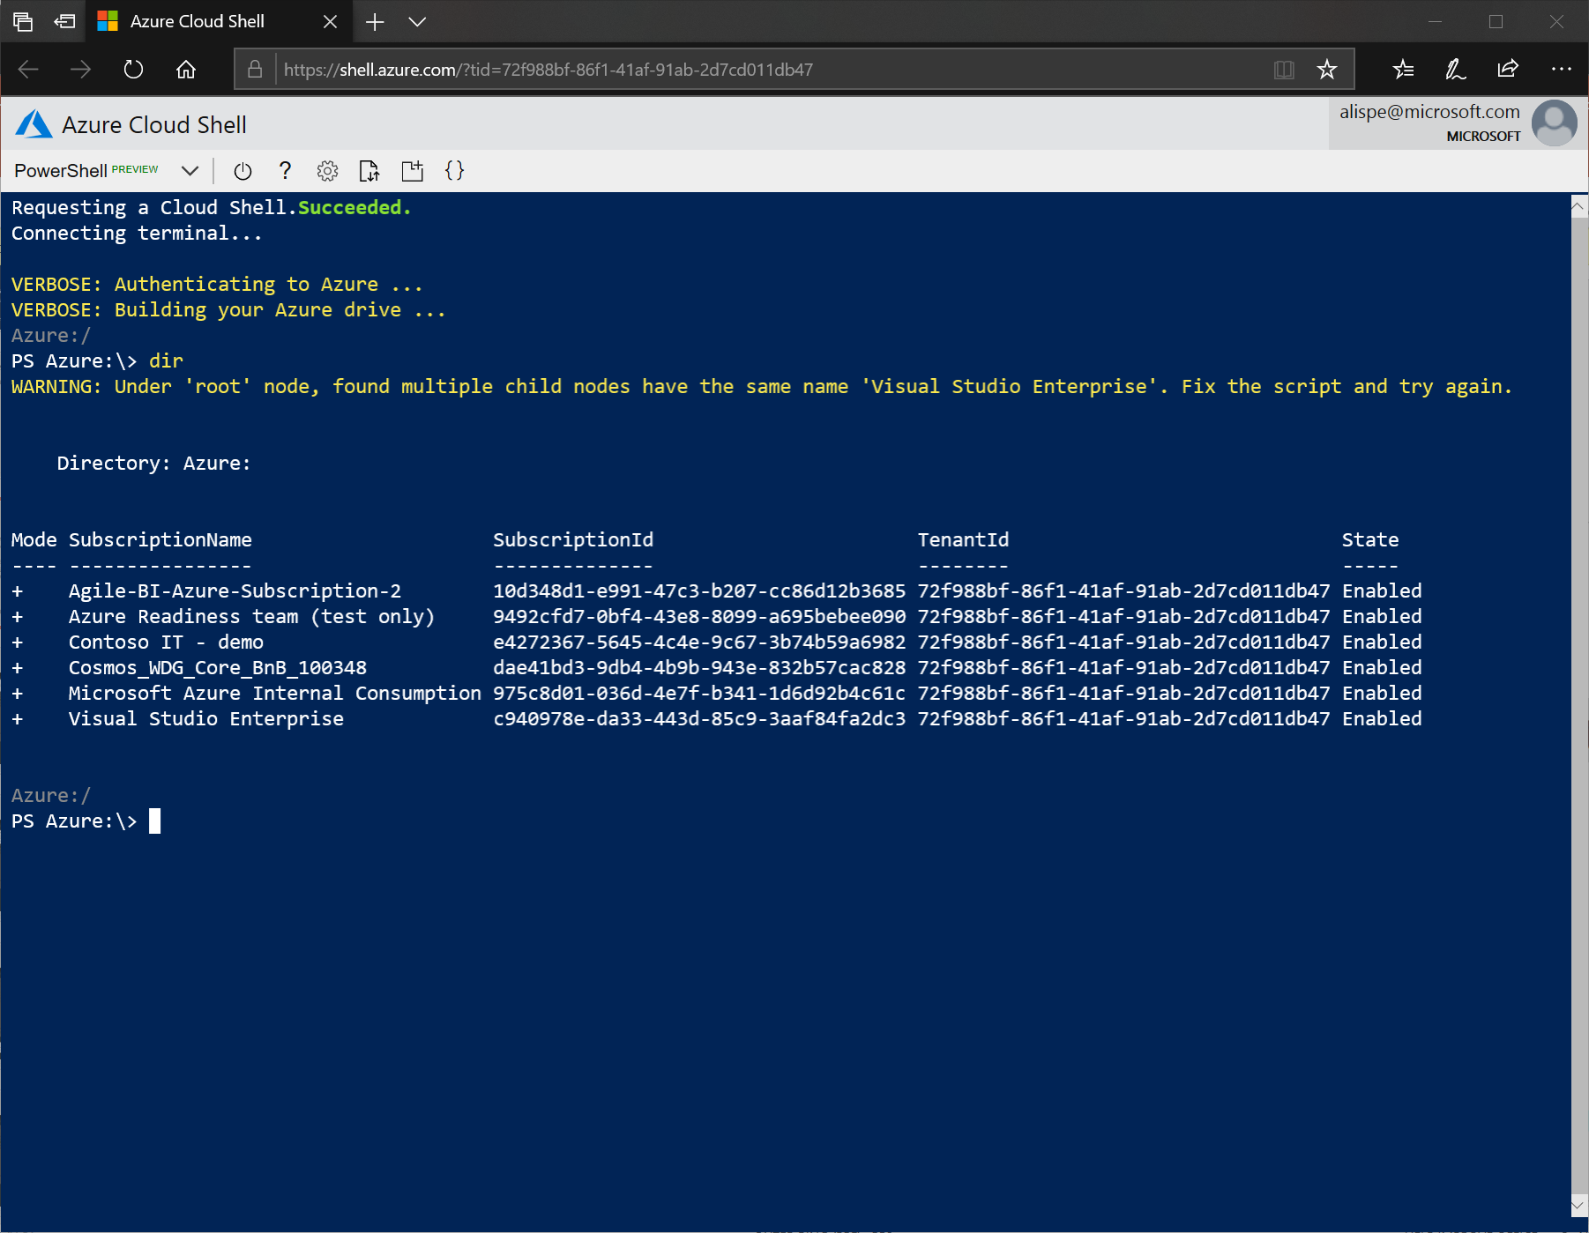
Azure Cloud Shell
Shell access from virtually anywhere
Common tools and programming languages included
Persist your files in attached cloud storage
Create and edit files in the Cloud Shell editor
Notes:
Support for PowerShell and Bash scripting and SDK for common languages and frameworks
Azure Resource Manager
(ARM templates)
Browser-based command line—
Cloud Shell (shell.azure.com)
Azure CLI is installed

Slide 5
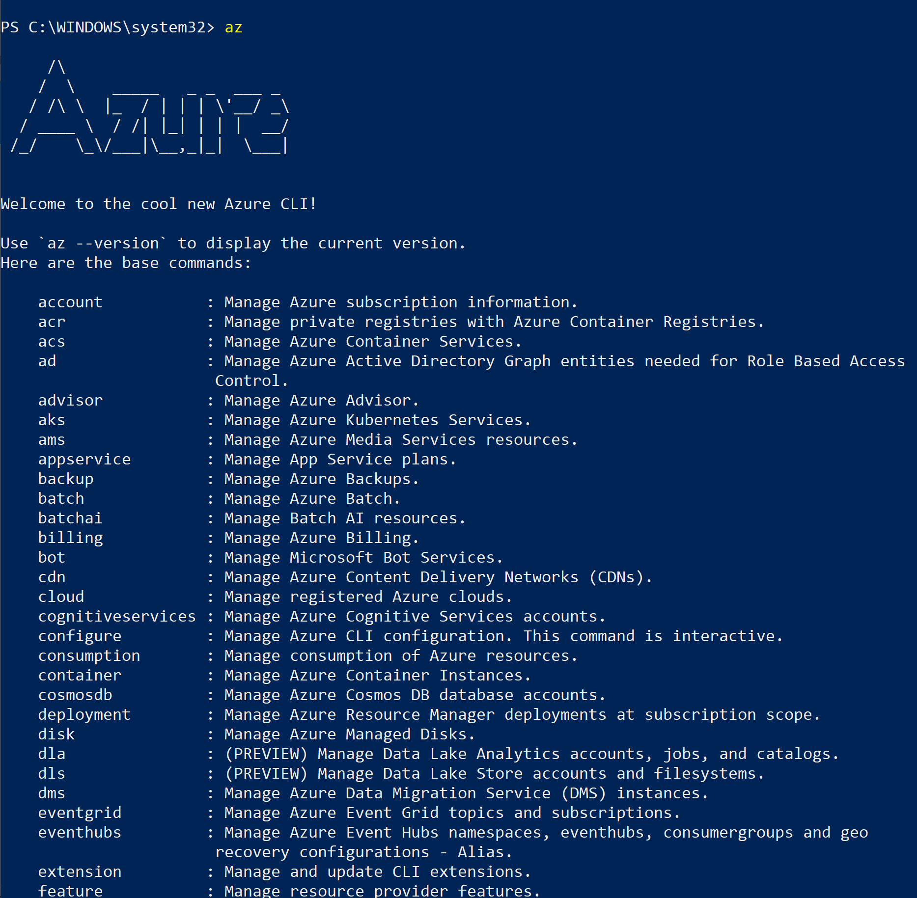
Azure CLI
Command Line Interface for Azure
Create/Manage/Query various Services
Cross Platform

Slide 6
Challenge 0 - Pre-requisites
Ready, Set, Go!
Form Your Team!
Download the Student Guide
  aka.ms/msoa-challenges
Join the MS Teams Channel (if applicable)
Login to the Azure Portal
In another window, login to the Azure Cloud Shell
List your subscriptions with the Azure CLI

Slide 7
Resource Groups
Logical groups of multiple resources of similar or different types
Every resource must be in a resource group, cannot be in more than one
Resources inside resource group may span across regions
Resource Group has a location for storing metadata
RESOU
R
CE G
R
OUP
Notes:
Logically group related resources such as storage accounts, virtual networks, and virtual machines (VMs) to deploy, manage, and maintain them as a single entity.
This approach makes it easier to deploy applications while keeping all the related resources together from a management perspective, or to grant others access to that group of resources

Slide 8
Challenge 1
First Thing is First!
Pick an Azure Data Center (closer is better)
  Create a variable with the Data Centers’ Scripting Name (ex. southcentralus)
Choose a globally unique, alpha-only, max 8 character code
Create a Resource Group

Slide 9
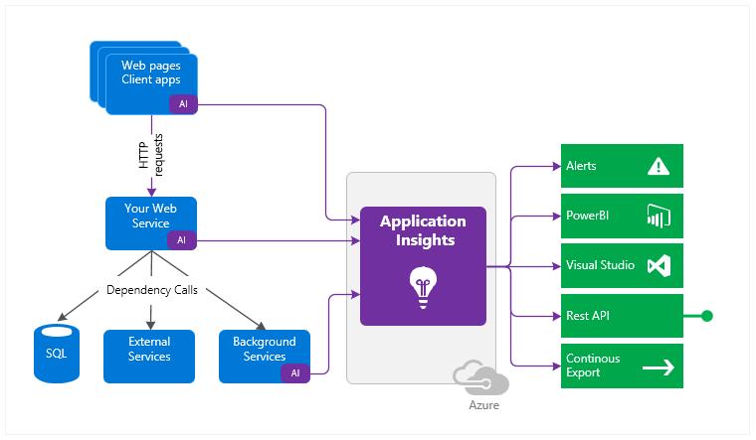
Application Insights
Azure Native APM Solution
  Profiler
  Application Map
  Usage Analysis
  Dashboarding/Alerting
  Live Mentrics Stream
Supports variety of dev platforms
  .Net Framework
  .Net Core
  Java
  NodeJS

Slide 10
Azure Resource Manager
Consistent Management Layer
Azure Resource Manager API

Slide 11
The template
Structure and elements
{
"$schema": "http://schema.management.azure.com/schemas/2015-01-01/deploymentTemplate.json#",
"contentVersion": "",
"parameters": { },
"variables": { },
"resources": [ ],
"outputs": { }
}
Declarative syntax
Allows you to declare the resources you want to have without having to write the script sequence of commands required to create it.

Slide 12
Challenge 2
Always need App Insights!
Deploy a publicly accessible ARM template that will deploy App Insights to your Resources Group
Set a variable with the InstrumentationKey for later

Slide 13



Azure Cosmos DB
A globally distributed, massively scalable, multi-model database service
SQL
MongoDB
Table API
Column-family
Document
Key-value
Graph
Guaranteed low latency
at the 99th percentile
Elastic scale out
of storage & throughput
Five well-defined
consistency models
Turnkey global
distribution
Comprehensive
SLAs
Notes:
Make sure to mention mulit-master with Serve <10 ms read and <15 ms write requests at the 99th percentile from the region nearest to users, while delivering data globally.

Slide 14
Request Units
Provisioned in terms of RU/sec
    Rate limiting based on amount of throughput provisioned
    Can be increased or decreased instantaneously
Metered Hourly
    Background processes like TTL expiration, index transformations scheduled when quiescent
Rate limit
Max RU/sec
Incoming Requests
No rate limiting
Min RU/sec
Replica Quiescent
Notes:
We want to avoid throttling (rate limiting)

Slide 15
Cosmos Database Representations
Account
Scaling RU‘s can occur at the
  Database level (shared)
  Collection level (individual)
Schema or Document Type is at the Collection level
Collection can be viewed as an isolated Domain Data Store
Database
Database
Database
Database
Database
Collection
Database
Database
Document
Notes:
An Account dictates

Slide 16
Challenge 3
Get some Data!
Create a CosmosDB Account
Set a variable with the PrimaryMasterKey for later

Slide 17
What is a Container
App
Container
App
Virtual machines
Containers
Virtualize the hardware
VMs as units of scaling
Virtualize the operating system
Applications as units of scaling
Notes:
Containers is a standard way of packaging an application and it’s dependencies
It’s great way to get to a density of compute, since each instance of a Container has less overhead than a VM.

Slide 18
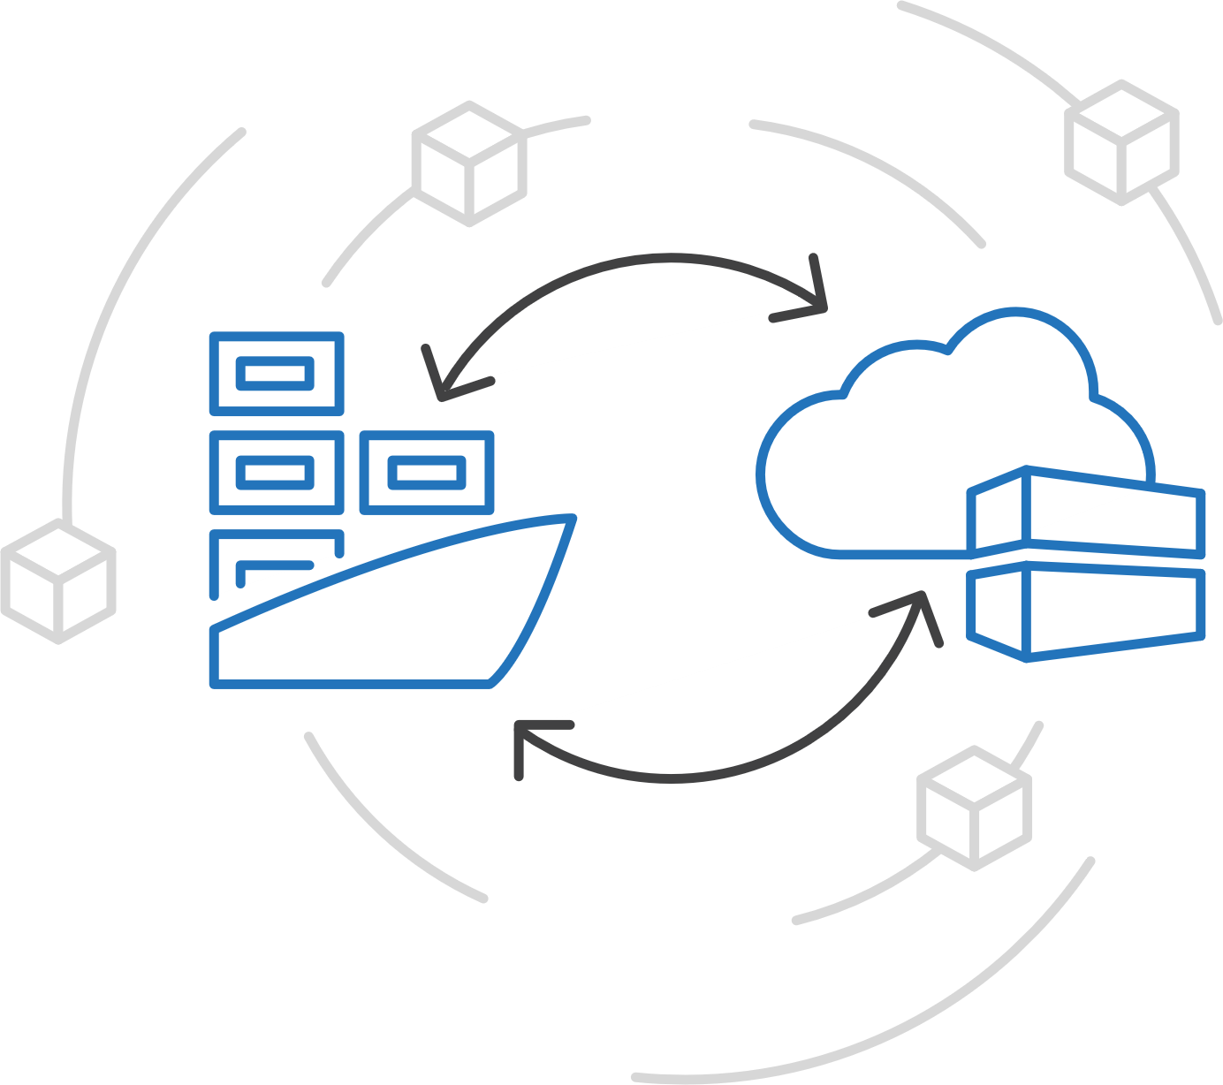
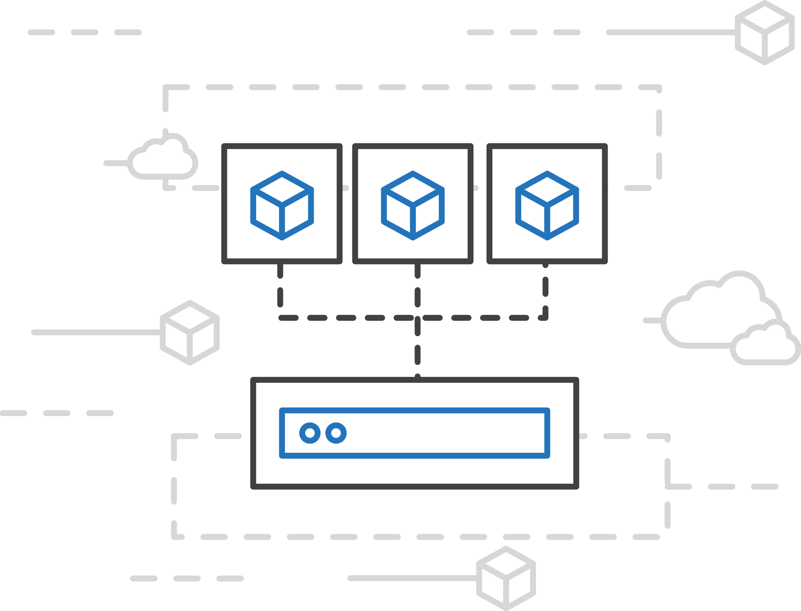
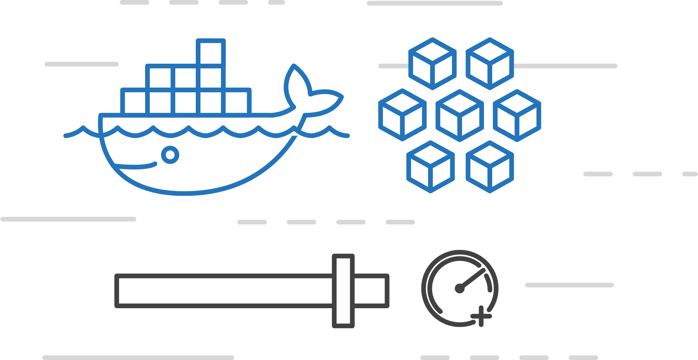
Azure Container Instances (ACI)
Easily run containers on Azure with a single command
Start using
containers right away
Cloud-scale container capacity
Hyper-visor isolation
Notes:
This is a PaaS hosting of Containers. Just spin up a container in seconds directly.
ACI deploys existing Container Images from either a public registry (Docker Hub) or a private registry (Azure Container Registry).

Slide 19
Challenge 4
Deploy some containers to ACI!
Deploy 3 public containers to ACI with configuration
  Data Service, Itinerary Service, Data Loader
Attach to one of them to see the Console output
Get the FQDN (Fully Qualify Domain Names) for the other 2

Slide 20
Azure App Service
Quickly build, deploy and scale powerful cloud applications without worrying about infrastructure
High productivity
.NET, Node, Java, Docker,
PHP, Ruby, Python
Staging &
deployment
Testing in
production
App gallery
marketplace
Fully managed
Auto scale &
load balancing
High availability
w/ auto patching
Reduced
operations costs
Backup &
recovery
Enterprise grade
Global data
center footprint
Hybrid
support
AAD
integration
Secure &
compliance
Notes:
App Service is a managed PaaS service that lets developers focus on the unique aspects of their app, instead of spending cycles on patching and boilerplate functionality.
Rapidly create and deploy web, mobile and API apps that scale with your business, on any platform
Free your developers from management of infrastructure
Automate and simplify your Azure deployments via integrated CI/CD capabilities with GitHub, VSTS and more
Multiple deployment slots for easy blue-green testing, A/B testing and simple rollbacks. Ultimately, you have much more control over how you do your staging.
Scale vertically and horizontally without downtime with integrated load balancer and in-memory caching – these things are baked into the platform
Meet rigorous performance, scalability, security, and compliance requirements using a single back end
There are lots of advantages here – which of these is most helpful to your business?

Slide 21
Challenge 5
Deploy the Web Site!
Create a Standard Linux App Service Plan
Create a Web App on the App Service Plan and deploy a Container
Configure it with Application Settings
Click around and play!

Slide 22
The Site Works!!!!!!
Now What?
Open the website (getting the URL from the Web App)
  Plan trips, switch browser, InPrivate/Incognito is your friend
Click the various services you created
Explore App Insights and all the data available
Click around and play!

Slide 23
Recap
You utilized the follow Azure Services
  Cosmos DB
  Container Instances
  App Insights
  App Services
You utilized the following Azure Tools
  Cloud Shell
  ARM Templates
  Portal
And when you are done playing, it cleans up in a few minutes
From scratch, you deployed a working microservices solution

Slide 24
Additional Resources
Azure Cloud Shell: https://docs.microsoft.com/en-us/azure/cloud-shell/overview
Install the Azure CLI: https://docs.microsoft.com/en-us/cli/azure/install-azure-cli?view=azure-cli-latest
Azure CLI Reference: https://docs.microsoft.com/en-us/cli/azure/reference-index?view=azure-cli-latest
Azure Naming Conventions: https://docs.microsoft.com/en-us/azure/architecture/best-practices/naming-conventions
App Insights: https://docs.microsoft.com/en-us/azure/azure-monitor/app/app-insights-overview
ARM Templates: https://docs.microsoft.com/en-us/azure/azure-resource-manager/resource-group-authoring-templates
Cosmos DB: https://docs.microsoft.com/en-us/azure/cosmos-db/
Azure Container Instances: https://docs.microsoft.com/en-us/azure/container-instances/
App Service Plans: https://docs.microsoft.com/en-us/azure/app-service/overview-hosting-plans
App Services: https://docs.microsoft.com/en-us/azure/app-service/

