Slide 1
Microsoft Teams
Come together to get work done
Name
Date
Notes:
Hello, I am [insert name, title].
We are all experiencing dramatic change in both work and life. COVID-19 has accelerated and changed trends across every industry. I’m here today to share how Microsoft Teams is uniquely positioned to enable this digital transformation and help with these rapidly changing realities.

Slide 2

Collaborate seamlessly as a team from anywhere
Organize your team
Create and share content
Stay in sync
Notes:
Microsoft Teams supports seamless collaboration so you can move your project or process forward from anywhere.
Organize your team
With Teams you can create a shared workspace for your team to organize conversations, files, tasks, and more. And when new people join the team, either from within or outside your organization, they get access the same historical conversations and content as everyone else.
Create and share content
It’s easy to share files with the team and you can even work together in real-time on the same file using Word, Excel, or PowerPoint, directly in Teams. When you want to share the file outside the team that’s as easy as sharing a link to that file.
Stay in sync
Instant messaging remains one of the most efficient means of communication to stay in sync. Teams allows you to quickly have those 1:1 or group chats to get help, take action, or simply check-in with a colleague.
Let’s go into a little more detail on each.

Slide 3
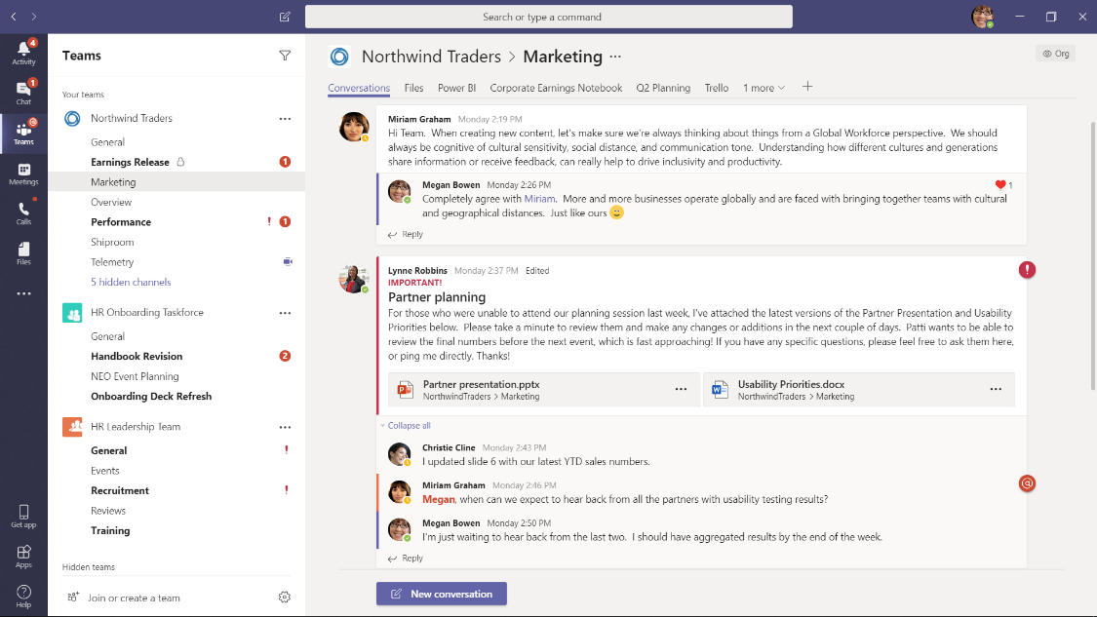
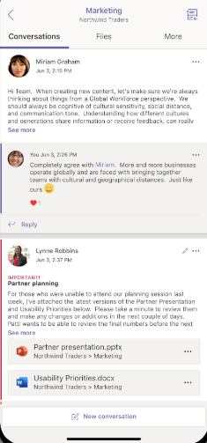
Organize your team in a shared workspace
Organize content and conversations together with public and private channels
Allow people outside your organization to participate with secure guest access
Manage plans, tasks, and list to ensure the team’s success
Integrate the apps from Microsoft or 3rd parties that your team uses regularly

Slide 4
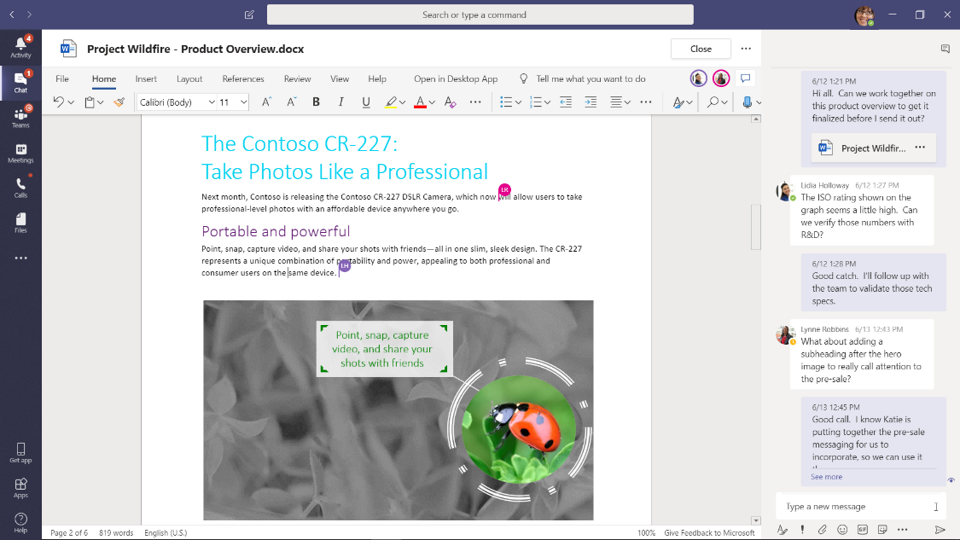
Share files and co-author in Word, Excel, and PowerPoint
Easily share files with people inside or outside your organization
Co-author documents in real-time directly in Teams
Maintain version history so you can revert change or recover when mistakes happen
Search across people, files, and chats to find what you need

Slide 5
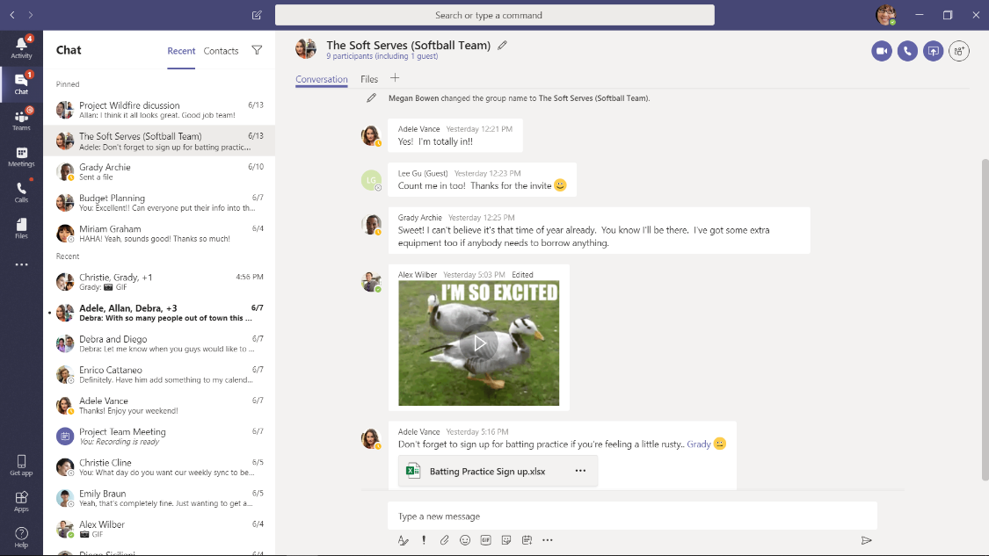
Stay in sync with persistent, threaded 1:1 and group chats
Effectively communicate with rich
formatting tools
Personalize your message and celebrate team moments with gifs, stickers, and emojis
Chat with people outside your organization with secure guest access

Slide 6



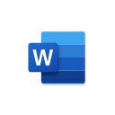

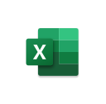







Customize Teams to meet your unique needs
Ready-made apps
+
hundreds of partner apps
Low-code apps & workflows
Power Apps
Build custom apps
Power Automate
Automate repetitive tasks
Power
Virtual Agents
Create tailored chatbots
Power BI
Visualize and discuss data
Full-code
custom solutions
Supply chain management
Industry event planning
New hire onboarding
Support and info
Notes:
OPTIONAL: For a ITDM audience
As you saw, we think of about the Teams platform as a spectrum – from those apps that are available off the shelf like SharePoint, Office apps, or any of the hundreds of partner apps that can be added to Teams. At the other end of the spectrum are the full-code solutions that you may have spent time and resources building for your organization – we want you to continue benefitting from those, while centralizing them and driving adoption by putting them where users are already working.

Slide 7

Stay connected across the spectrum of meeting types
1:1 Meetings and Calls
Group Meetings
Events
Notes:
With this in mind, we have reimagined the meetings and virtual events space to support the broad spectrum of meeting types. From daily meetings that drive employee productivity, to virtual events that improve customer engagement – Teams can support all your calling, online meeting, and event needs. This includes:
1:1 Meetings and Calling
As people continue to work from home while others return to the workplace, Teams can keep help them stay connected with 1:1 meetings and calling options.
Group Meetings
With group meetings, Microsoft Teams takes a smarter approach, making them more engaging and inclusive, before, during, and after a meeting. We are also re-imagining capabilities for meeting rooms that offer touchless experiences that enhance collaboration for both in-room and remote participants.
Large events
Lastly, Teams also allows you to connect with larger audiences of up to 20,000 through engaging video broadcasts. This can include internal events such as townhalls or all-hands or external events such as a webinar.

Slide 8
Challenge 1 Demo
Channels, Chat, and Tabs
Meetings
Live Events

Slide 9


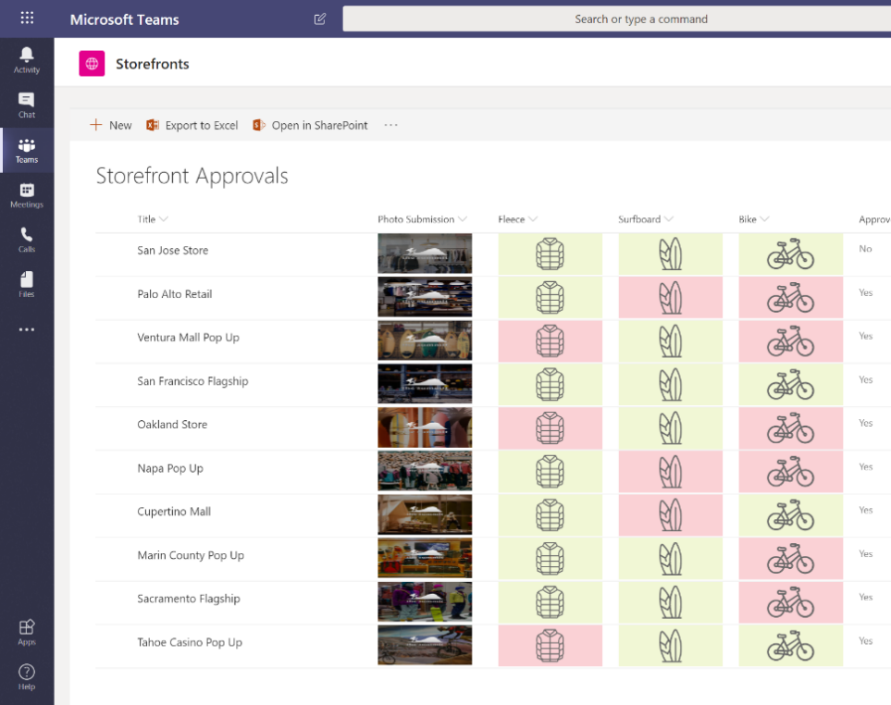
Create solutions with shared data and files in SharePoint
Gather and collaborate on shared information in lists and libraries that support up to 30 million items
Incorporate rich data types including pictures, people, URLs and locations
Create data visualizations and experiences with custom formatting, custom forms and dashboards
Import data from and export to Excel and edit data with worksheet-like simplicity
Manage information with item-level security and enterprise-grade compliance features
Notes:
Teams also integrates with and is built on the same SharePoint architecture that you are familiar with. This means the features and functionality that you’ve become familiar with when using SharePoint will carry over to much of your Teams experience.
For end users, they’ll experience: Simple, consistent and secure file access and sharing experiences across Office 365 apps and devices, Office document co-authoring with the latest Office desktop clients, mobile apps, and Office Online, and intelligent features like personalized search and discovery, recommended content, most recently used, trending sites, viewing insights
For IT and developers, they’ll find familiar features like: Intelligent, built-in security consistent across Office 365, including DLP, conditional access, ATP, ransomware recovery with Files Restore, etc., Unified management – common admin, governance and management across users, apps, devices and services, and Extensibility – since SharePoint files, sites, lists and pages are available in the Microsoft Graph, developers can use the single Graph API to connect to 3rd party services and build custom solutions

Slide 10

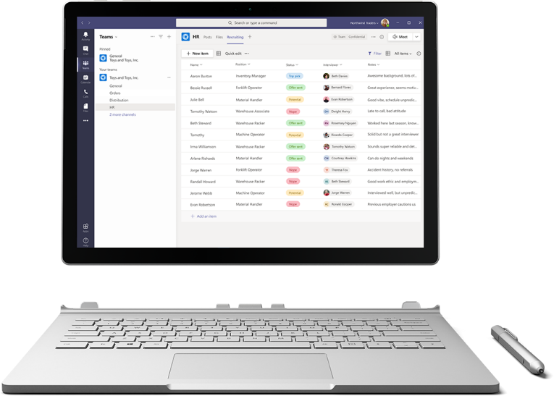
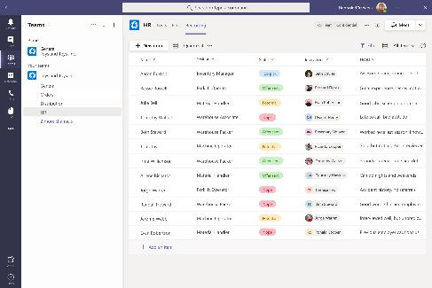

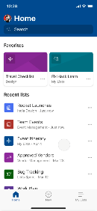
Track what matters most with Microsoft Lists
Simple
Easily create, share, and track lists with anyone, on any device
Smart
Keep everyone in sync with rules and quick edits
Flexible
Customize your lists for whatever your business needs
Notes:
At the Build conference this year, we launched a new M365 app called Microsoft Lists. This app is designed to help you track information and organize work. If you’re one of the millions of people already using SharePoint lists to track and organize work, the Lists app makes it easier than ever before to get back to the lists you rely on. If you are new to the world of Lists, I hope this presentation convinces you to go out and give them a try.
Think of Lists as lightweight databases that anybody can create and customize. At the heart of every list is a flexible table of data, where you can define the schema of the items you want to track. Using this power, anybody can start a list to track anything and everything that matters, including issues, assets, routines, contacts, inventory and more. If you’re not into defining your own schema, that’s OK, we’ve got you covered with our library of out of the box list templates – I’ll show you some of them in a bit.
The power of Lists as lightweight databases becomes evident when you start layering custom formatting, views, and automations on top of your data to help your team stay productive and focused on what needs to get done. In this session, we show you how to do this, and more, in the browser, in Teams, and on your mobile device. And the best part is, because Lists are a part of Microsoft 365, you can rely on enterprise-ready security and compliance for everything see here.

Slide 11
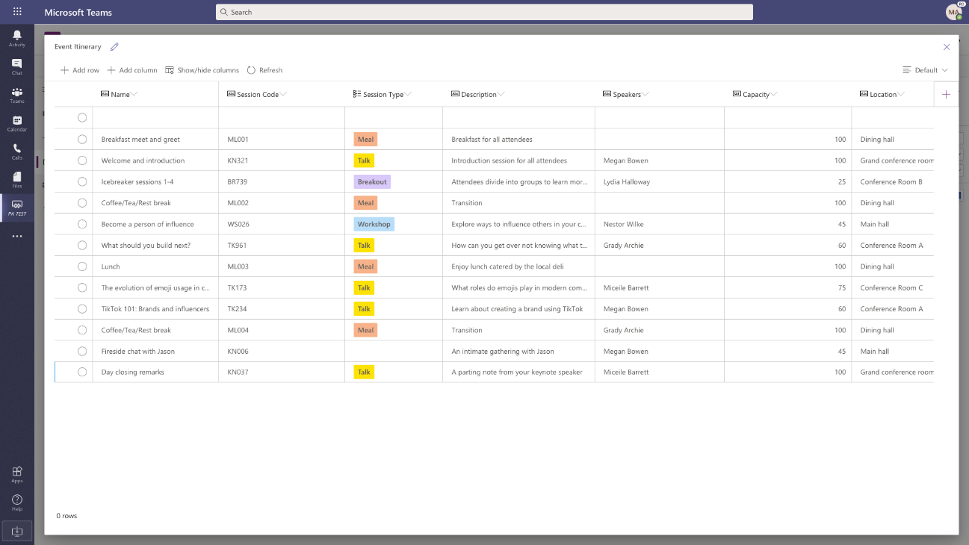




Introducing Microsoft Dataverse for Teams
A built-in low code data platform for Microsoft Teams.
A subset of the capabilities of the data platform behind Dynamics 365 and Power Platform.
Provides storage, rich data types with enterprise capabilities, and one-click solution deployment.
Included for every Teams customer, governable by IT.

Slide 12



What’s GA in Teams + Power Platform
Teams + Power Apps
Embedded Power Apps studio in Teams
Ready-made solutions in the Teams app store
Dataverse for Teams - database with rich data types available for use in Teams
Power Apps-in-Teams usage data in Teams Admin Center
Responsive app containers
Teams + Power Automate
New Power Automate app for Teams with easy-to-use templates + diet designer
Integrated Approvals, including e-sign integrations
Improved automation for teams, channels, chats, and meetings
New automation entry points
Teams + Power Virtual Agents
Embedded Power Virtual Agents studio in Teams
Seamless bot publishing to Teams app store
Personalized bot responses specific to the end user
Seeded Power Virtual Agents capabilities in Office 365/Microsoft 365
Dataverse for Teams - database with rich data types available for use in Teams

Slide 13

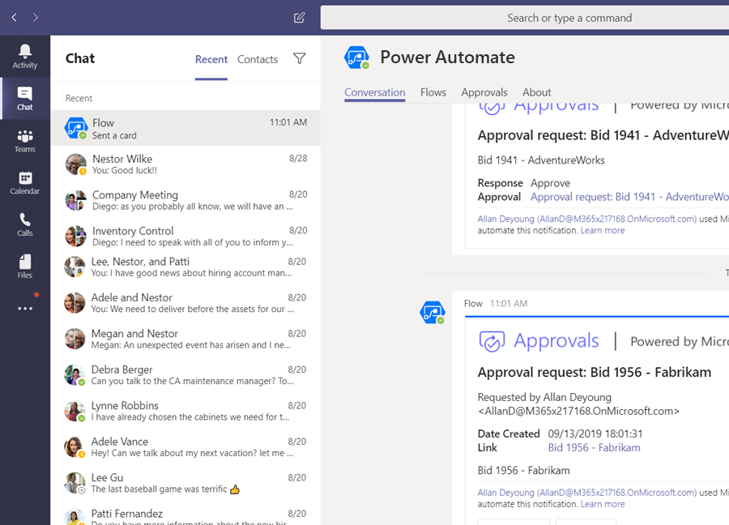
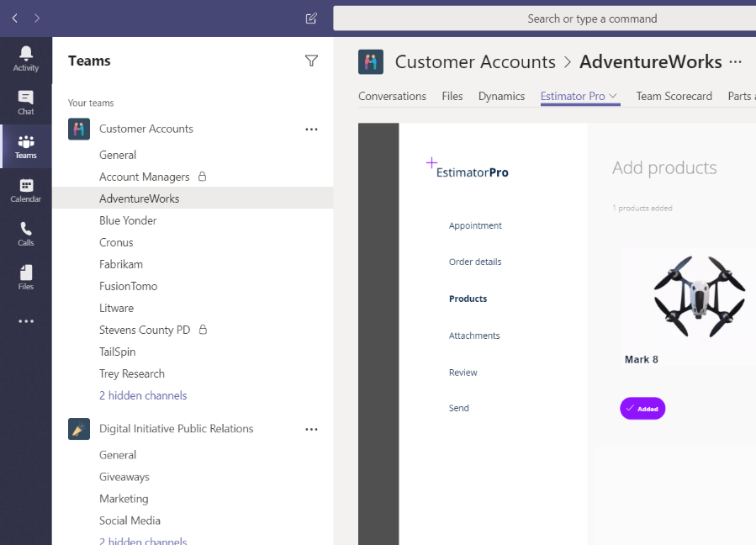
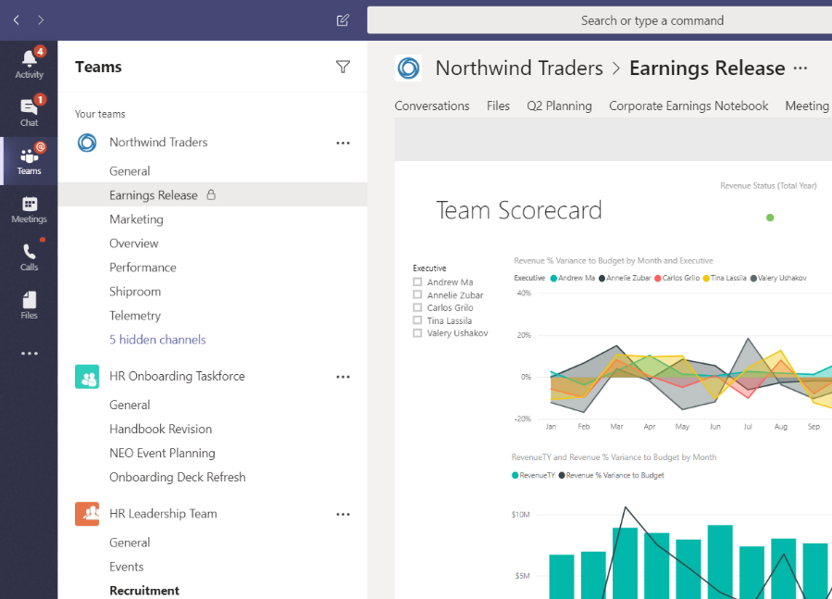

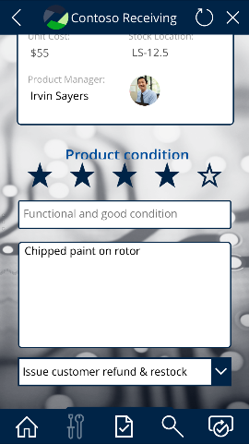
Low-code dev & automation: Teams + Power Platform
Power BI
Seamlessly connect and transform data into accessible visualizations, to make decisions quickly and confidently
Power Apps
Easily create custom apps to modernize processes to meet your needs with your data, enhancing efficiency and collaboration
Power Automate
Quickly automate intelligent, data-powered workflows, from simple tasks to radical transformations, improving agility and productivity
Notes:
The Microsoft Power Platform is a suite of low code development tools that includes Power BI, Power Apps, and Power Automate (formerly known as Microsoft Flow). We feel that integrating Power Platform with Teams really enhances both Teams and the Power Platform tools – they make Teams more powerful, no pun intended, and Teams allows you to put all these tools into one place, and really take advantage of the conversational nature of Teams.
​Power BI​
​Power BI is the Power Platform’s data visualization tool, leveraging all of the rich data collected in Microsoft 365 and enhanced by PowerApps and Power Automate. Power BI helps your organization make data-driven decisions and empowers people across your business to derive insights from the data that matters most. The natural connection between Power BI and PowerApps makes it effortless to put insights in the hands of people like maintenance workers, teachers, miners and others on the frontline, in tailored and often task-specific applications that supercharge their productivity.​
<Click>
​
Power Apps​
​PowerApps is our low code application development platform – allowing anyone to build web and mobile applications with little or no code. PowerApps connects to hundreds of business systems and databases, making it easy to link workers with the existing processes and data that makes the business tick. Your custom apps created with Power Apps can also live exactly where users need them – either pinned to a channel, or on the left app bar of Teams. A new Power Apps feature allows you to publish apps created in Power Apps directly as Teams apps – so they look and feel just like any other app that lives in the Teams app library. And, all the data captured in PowerApps can make its way right back to those very systems for further analysis. ​
<Click>
Power Automate​
​Microsoft Power Automate allows you to automate routine processes and tasks. Since Power Automate is integrated with Microsoft 365 applications you can automate many of your processes that have Office and other Microsoft apps involved, typically with no significant coding to get started. Power Automate’s integration with Teams which can be built directly from Teams and automate processes in the context of a chat. Users can even take actions directly from chat.
Teams combined with Microsoft Power Platform’s low-code technology allows integrate existing apps, create apps new, automate processes between apps or within apps, and foster a data-driven culture.
*Note: Power Apps and Power Automate are subject to usage limits under Microsoft 365 licensing, and certain features/functionality and additional capacity require the purchase of additional plan(s); Power BI requires an E5 license or an add-on – please check licensing guidance for more information

Slide 14
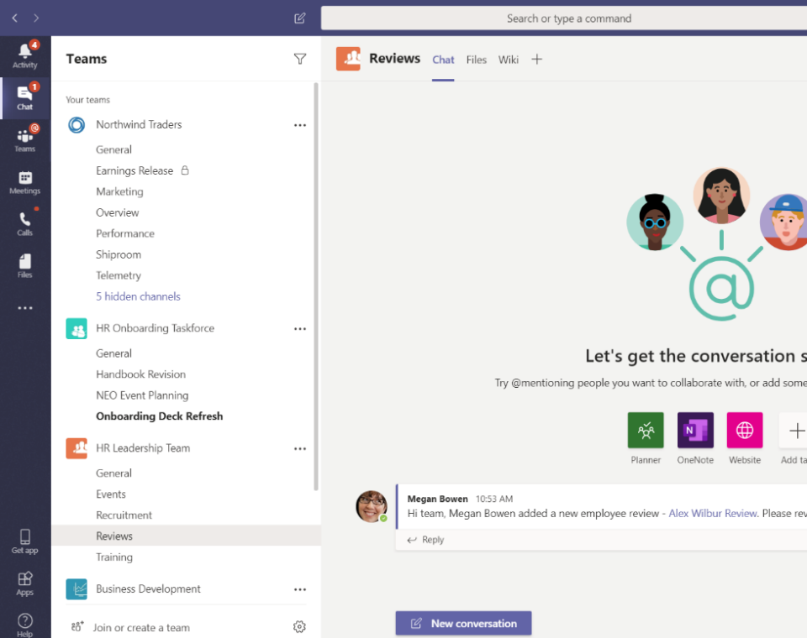
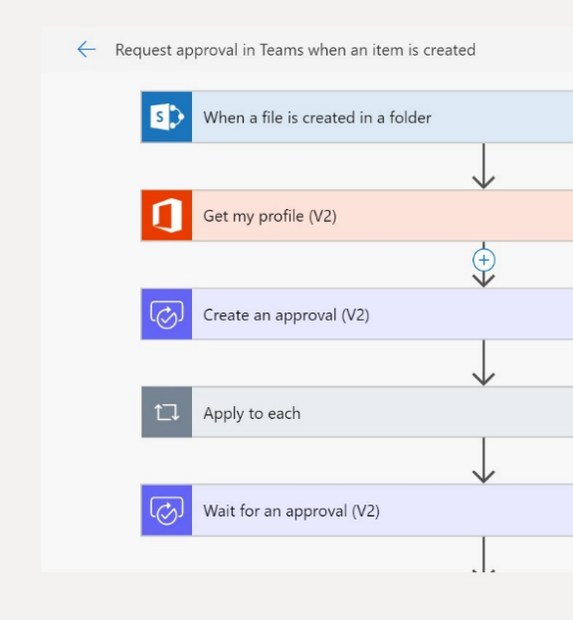
Automate routine tasks with Microsoft Power Automate
Automate existing business processes with low-code solutions​
Connect and automate 300+ cloud and on-premises data services
Use prebuilt templates for business processes like approvals, alerts, data collection and reminders
Use advanced scenarios with branching conditions, multiple steps, Visio process modeling, and more
* Some features vary by license type
Notes:
With Microsoft Power Automate you can processes events from hundreds of triggers out-of-box to start flows – plus custom events in external systems through custom connectors
After the triggering a flow, actions can read and write data in any of the hundreds of connectors in integration workflows
Power Automate allows you to quickly automate business processes that span across apps and services using a familiar form-based interface. This allows new users to feel comfortable and quickly learn how to use Power Automate.
Many common tasks, like approvals are easy to set up in Power Automate. Power Automate can easily create approvals that can be handled from inside Teams on desktop or mobile devices.
Everything from simple if-this-then-that processes to detailed conditional branching that leverages the Microsoft Cognitive Services for AI-powered decision making can be created using Power Automate.
*Note: Power Apps and Power Automate are subject to usage limits under Microsoft 365 licensing, and certain features/functionality and additional capacity require the purchase of additional plan(s); Power BI requires an E5 license or an add-on – please check licensing guidance for more information

Slide 15
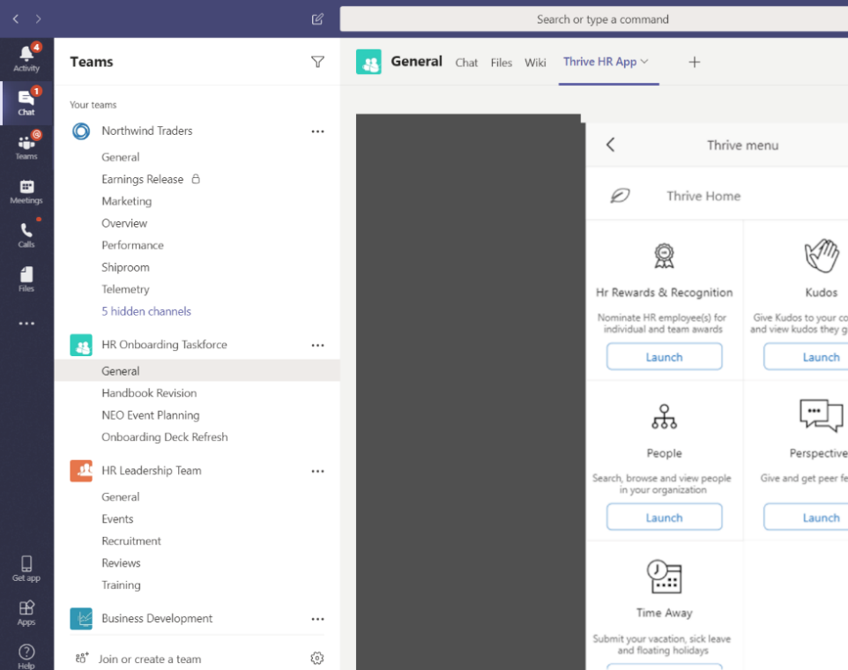
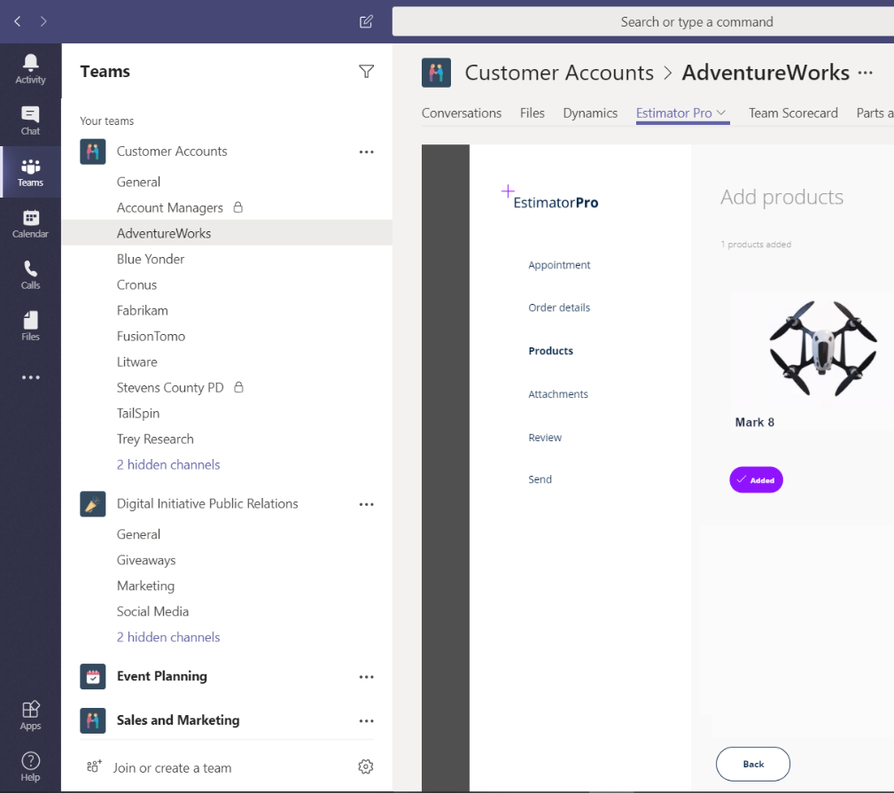
Build custom apps with PowerApps
Build low-code apps for PC and mobile for use within Microsoft Teams
Access PowerApps within a Teams channel
Share the apps you create with your organization to use in Teams
Connect to business data in SharePoint lists, CDS, or any of 300+ connected services
Notes:
Next, let’s discuss Microsoft PowerApps. PowerApps helps you build standalone web and mobile apps, or customize existing apps in Office 365 to deliver a seamless experience across channels. PowerApps lets you do all of this with no or low coding effort.
You can craft pixel-perfect experiences from a blank canvas for highly customized, task and role based apps or start with a number of ready-made templates that can get you started building your first app. For more complex solutions, there is a back end where code can be customized to make truly unique and powerful apps.
Once you have built a PowerApp, it can be integrated with Teams by adding it to a tab in a channel or chat.
PowerApps simplifies the process to develop immersive, declarative, responsive apps from a rich data model and workflow engine.
It allows you to connect with hundreds of data sources for events and actions, from Microsoft and other vendors.
PowerApps helps you leverage native mobile capabilities like camera, GPS, push notifications, add custom controls and more to build consumer grade applications
For more advanced apps, you can create solutions with intelligence including Natural Language Processing, image detection, and other built-in cognitive services powered by Azure
Again, all of these rich features and functions can be brought to life with very little custom code required.
*Note: Power Apps and Power Automate are subject to usage limits under Microsoft 365 licensing, and certain features/functionality and additional capacity require the purchase of additional plan(s); Power BI requires an E5 license or an add-on – please check licensing guidance for more information

Slide 16
Challenge 2 Demo
Microsoft (SharePoint) Lists
Power Automate
Microsoft Dataverse for Teams

Slide 17

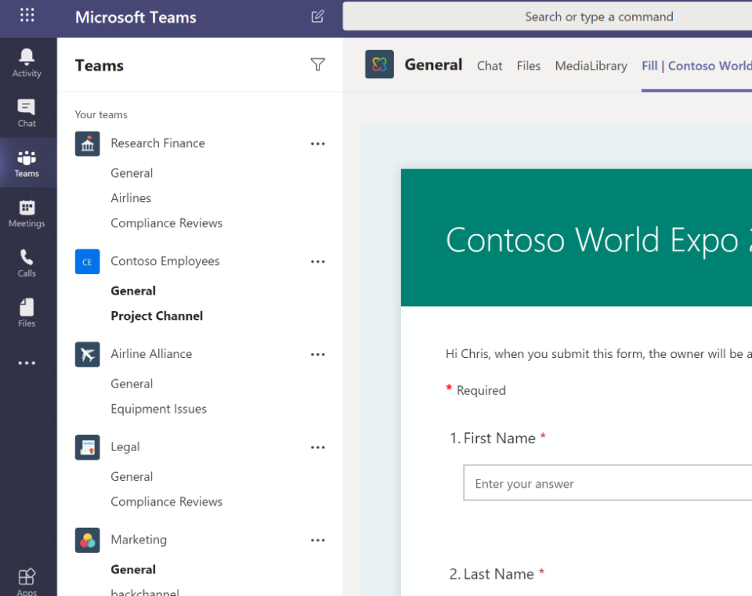
Collect information with Microsoft Forms
Integrate with Microsoft Teams using web parts and chatbot integration
Collect data by adding a form to a Teams channel
Solve sophisticated needs with question branching and file uploads
Save data in SharePoint lists and deliver notifications with Microsoft Power Automate
Create polls, quizzes, and surveys
Share forms with anyone inside or outside
your organization
Notes:
Another product that seamlessly integrates into Teams and provides your business with enhanced insights and data is Microsoft Forms. Forms is a simple and easy way to create survey.
You can create and send forms in minutes - Forms is simple and easy to use and looks great on any web browser or device. Preset themes and question branching make surveys, polls, and quizzes look great without a lot of work
You can make better decisions with data - Microsoft Forms allows you to gather business insights in real time with automatic charts and easy filtering. You can export to Excel for even more in-depth analysis takes just one click.

Slide 18
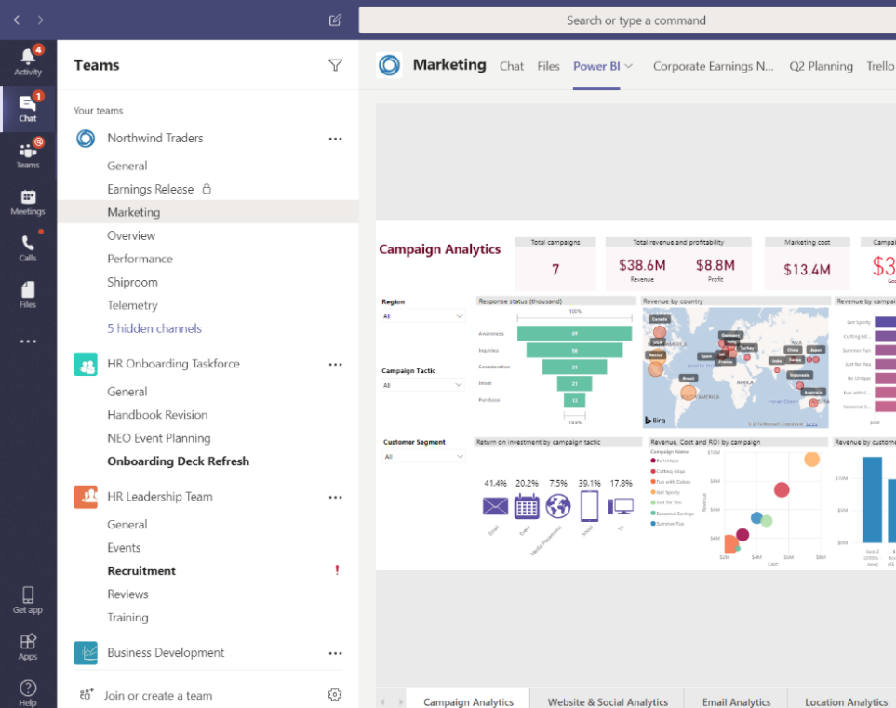
Uncover insights with Power BI
Make sense of data with beautiful and insightful visualizations
Add Power BI reports as a tab in Teams' channel or to custom dashboards
Share data insights during meetings in Teams
Easily create reports from Excel or CSV files in SharePoint libraries
Use AI to get insights faster
Notes:
Power BI is a business analytics service within Microsoft Power Platform that delivers insights to enable fast, informed decisions.
Power BI allows you to transform data into stunning visuals and share them with colleagues on any device. You can visually explore and analyze data — on-premises and in the cloud — all in one view.
This tool allows you to collaborate on and share customized dashboards and interactive reports, and you can scale across your organization with built-in governance and security.
To take your collaboration to the next level, you can integrate these dashboards into Teams so your entire organization can get critical data where they are working, allowing your organization can build a data-driven culture.
*Note: Power Apps and Power Automate are subject to usage limits under Microsoft 365 licensing, and certain features/functionality and additional capacity require the purchase of additional plan(s); Power BI requires an E5 license or an add-on – please check licensing guidance for more information

Slide 19
Challenge 3 Demo
Microsoft Forms
Power BI

